Slide 1
INNOMATICS RESEARCH LABS
INNOVATION • AUTOMATION • ANALYTICS
PROJECT ON
E-commerce Sales
Analytics System
Customer Segmentation • Revenue Trends • Return & Payment Analytics
Presented by: SAKSHITH GANGI

Slide 2

About Me
Background: Computer Science and Engineering graduate specializing in Data Science. Why Data Science: I enjoy programming, but I realized I was more interested in understanding data and solving analytical problems than building full-stack applications. Data Science allows me to combine programming, statistics, and business understanding, which matches my interests and strengths. LinkedIn: linkedin.com/in/sakshith-gangi-699815258 GitHub: github.com/sakshithyadav
02

Slide 3
Agenda
1
Objective of the Project
2
Key Analysis Questions (Use Cases)
3
Conclusion (Key Findings Overall)
4
Q&A Slide
5
Challenges Faced / Key Learnings
03

Slide 4
Objective of the Project
Analyze the E-commerce Sales Analytics database to uncover actionable insights regarding customer value, revenue trends, product performance, and operational risk.
Execute complex multi-table SQL queries — joins, window functions, and conditional aggregation — across 7 interconnected tables (customers, suppliers, products, orders, order_items, payments, returns).
Track customer segmentation, revenue growth, and return / payment failure patterns to support marketing, inventory, and checkout-optimization decisions.
Keywords: Customer Segmentation • Revenue Trend Analysis • Return Rate • Payment Failure Analysis • Window Functions
04

Slide 5
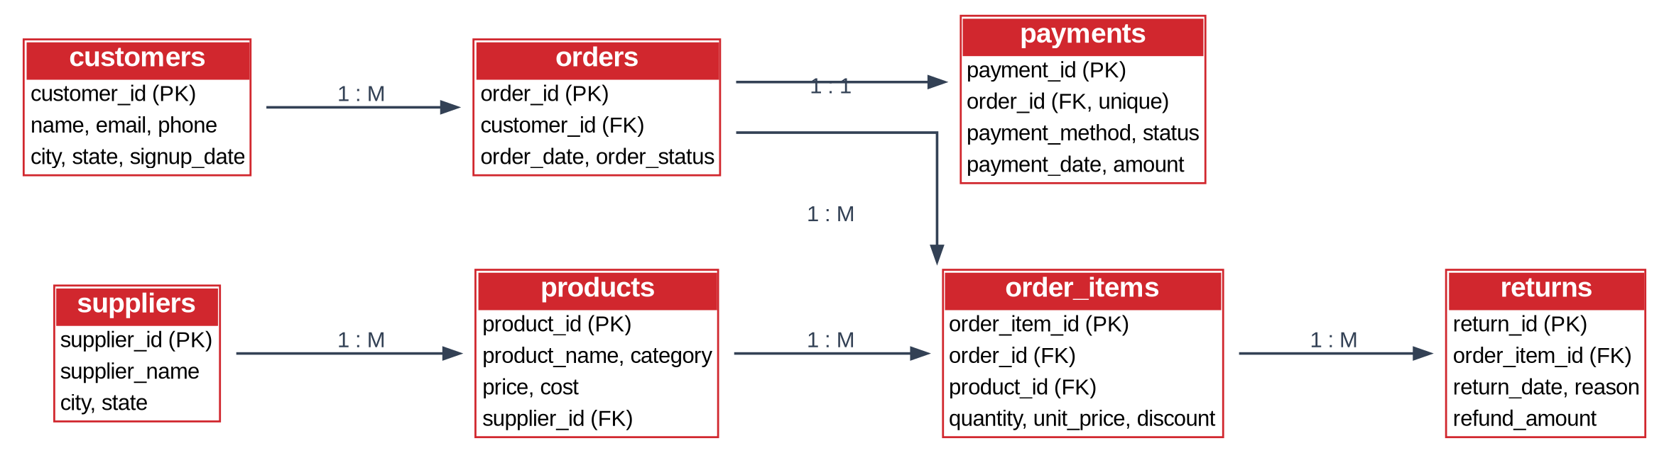
ER Diagram
05

Slide 6
Schema Architecture
Table | Columns | Relationships
customers | customer_id (PK), name, email, phone, city, state, signup_date | 1-to-M with Orders
suppliers | supplier_id (PK), supplier_name, city, state | 1-to-M with Products
products | product_id (PK), product_name, category, price, cost, supplier_id (FK) | M-to-1 Suppliers; 1-to-M Order_Items
orders | order_id (PK), customer_id (FK), order_date, order_status | M-to-1 Customers; 1-to-M Items; 1-to-1 Payments
order_items | order_item_id (PK), order_id (FK), product_id (FK), quantity, unit_price | M-to-1 Orders & Products; 1-to-M Returns
payments | payment_id (PK), order_id (FK, unique), method, status, amount | 1-to-1 with Orders
returns | return_id (PK), order_item_id (FK), return_date, reason, refund_amount | M-to-1 with Order_Items
06

Slide 7
Key Analysis Questions
Customer, Revenue, Product & Risk Analysis — Business Question → SQL Technique Used
1.
Is revenue growing or declining month over month?
Window function — LAG()
2.
Which customers are VIP, regular, or at risk of churn?
CASE segmentation + DATEDIFF
3.
What are the top 3 products per category by revenue?
Window function — RANK() / PARTITION BY
4.
Which product categories have the highest return rates?
LEFT JOIN + conditional aggregation
5.
Which payment methods have the highest failure rates?
Conditional aggregation — CASE / SUM
6.
Can the business get an on-demand monthly sales report?
Stored Procedure
07

Slide 8
$
Business & Revenue Analysis
Six business questions, solved with SQL
08

Slide 9
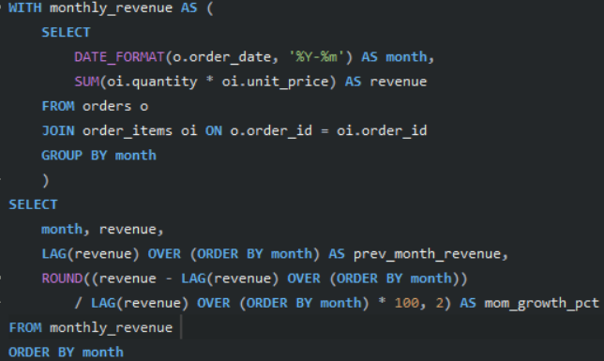
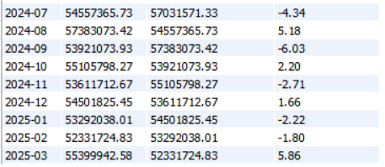
Q1. Is revenue growing or declining month over month?
Key Insights:
Revenue stayed stable at around ₹5.2–5.7 Cr per month, with no clear growth or decline.
Monthly changes were small (about ±2–6%), showing consistent performance
09

Slide 10
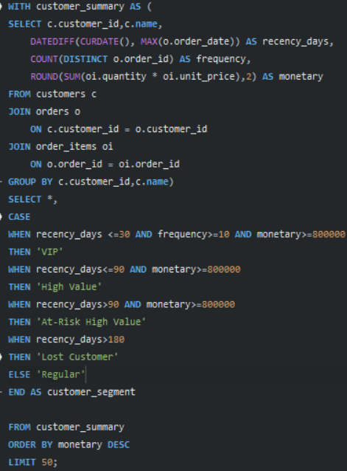
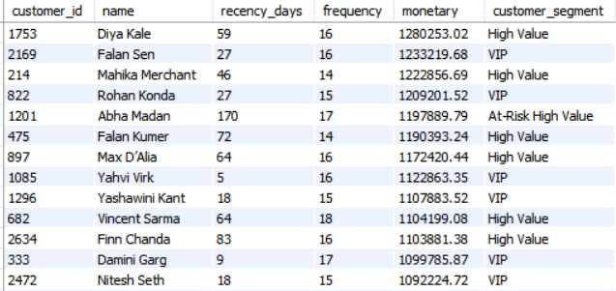
Q2. Which customers are VIP, regular, or at risk of churn?
Key Insights:
Diya kale is the top spent customer, with ₹12.80L spent across 16 orders, but no purchase in 59 days.
Customer segments were created using simple business rules (spend, orders, and last purchase), making them easy to understand.
Most high-spending customers are still active, with only a few in the At-Risk category.
10

Slide 11
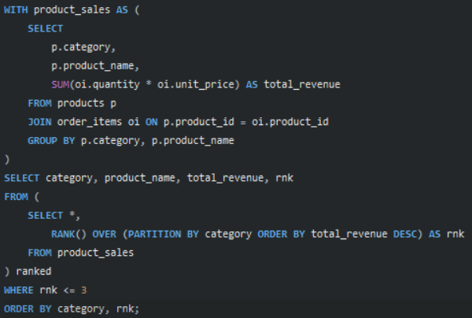
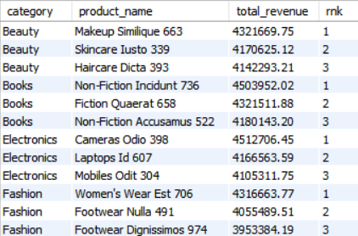
Q3. What are the top 3 products per category by revenue?
Key Insights:
The top 3 products in each category have similar revenue, with no single product dominating.
Inventory and marketing should be shared across the top products instead of focusing on just one.
All 8 categories have different top-selling products, showing revenue is well distributed across the catalog.
11

Slide 12
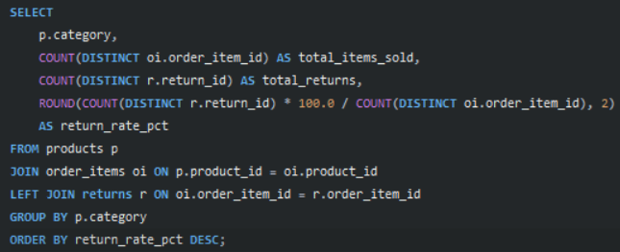
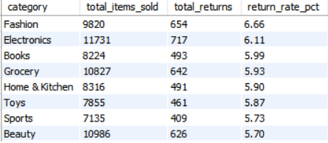
Q4. Which product categories have the highest return rates?
Key Insights:
Fashion has the highest return rate (6.66%), likely due to size and fit issues.
Return rates are similar across all categories (5.70%–6.66%), showing consistent performance.
The overall return rate is around 6%, matching the expected rate in the synthetic dataset.
12

Slide 13
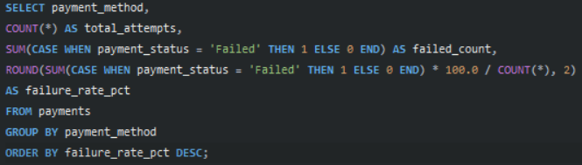
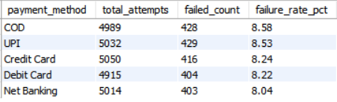
Q5. Which payment methods have the highest failure rates?
Key Insights:
COD has the highest failure rate (8.58%), mainly due to delivery refusals or customer unavailability.
Failure rates are similar across all payment methods (8.04%–8.58%), with no major payment issue.
Net Banking has the lowest failure rate (8.04%), making it the most reliable payment method.
13

Slide 14
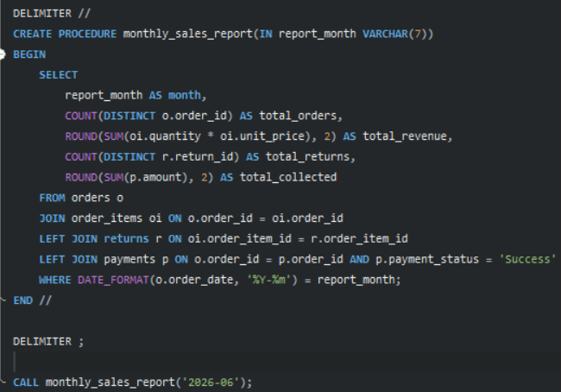

Q6. Can the business get an on-demand monthly sales report?
909
₹5.19 Cr
179
Total Orders
Total Revenue
Total Returns
Key Insights:
The Stored procedure provides a monthly summary(orders,revenue, and returns) with a single call,eliminating the need to write queries
14

Slide 15
Challenges Faced / Key Learnings
Challenges Faced
Key Learnings
Handled incomplete monthly data that effected revenue analysis.
Designed a well-structured database with proper table relationships and constraints
Defined practical business rules for customer segmentation
Gained hands-on experience with window functions for trend and ranking analysis.
Built simple and easy-to-understand customer segmentation using CASE statements
Improved query performance using indexes.
15

Slide 16
Conclusion (Key Findings Overall)
01
02
Stable Revenue, No Growth Trend
High-Value Churn Risk Identified
Revenue held steady between ₹5.2–5.7 Cr/month with no sustained growth or decline across the ~2-year window.
Customer diya kale shows ₹12.80L in lifetime spend but 59 days of inactivity — the clearest win-back priority.
03
04
Fashion Leads Category Returns
COD Has the Highest Payment Failure
Return rates cluster tightly between 5.70%–6.66% across categories, with Fashion the highest at 6.66%.
Failure rates range narrowly from 8.04%–8.58% across methods, with COD the least reliable at checkout.
16

Slide 17
?
Q&A
Open Discussion & Clarifications
17

Slide 18
THANK YOU
SQL • E-commerce Sales Analytics System

